Slide 1
Module – 5 Introduction to Object-Oriented Programming

Slide 2
Procedural Oriented Programming (POP)
In the procedure-oriented approach, large programs are divided into smaller programs known as functions.
In POP, a program is written as a sequence of procedures or function.
In POP, each procedure (function) contains a series of instructions for performing a specific task.
During the program execution each procedure (function) can be called by the other procedures.
To call a procedure (function), we have to write function name only.
While we concentrate onto the development of functions, we give very little attention to the data that are being used by various functions.
In POP, the major emphasis is on procedure (function) and not on the data.
In a multi-function program, many important data items are placed as global so that they may be accessed by all the functions. Each function may have its own local data.
Global data are more vulnerable to an accidental change by a function. In a large program it is very difficult to identify what data is used by which function.
Examples of procedural oriented programming language are COBOL, FORTRAN, PASCAL, C programming language etc.

Slide 3
Drawback
In POP, global data can be accessed and changed by any procedure (function) so there is no data security.
In case we want to change the type of data of global data, then we also need to resolve all functions that access the data. Due to this, it may happen that some errors will occur
POP does not model real-world problems because functions are action-oriented.

Slide 4
Object-Oriented Programming (OOP)
OOP treats data as a critical element in the program development and does not allow it to flow freely around the system.
In OOP, the major emphasis is on data rather than procedure (function).
It ties data more closely to the function that operate on it, and protects it from accidental modification from outside function.
OOP allows decomposition of a problem into a number of entities called objects and then builds data and function around these objects.
The data of an object can be accessed only by the function associated with that object. However, function of one object can access the function of other objects.
C++, Java, Dot Net, Python etc are the example of Object oriented programming (OOP) language.

Slide 5
Some Characteristics of Object Oriented Programming
Emphasis is on data rather than procedure (function).
Programs are divided into objects.
Functions that operate on the data of an object are ties together in the data structure.
Data is hidden and cannot be accessed by external function.
Objects may communicate with each other through function.
New data and functions can be easily added whenever necessary.
Follows bottom up approach in program design.

Slide 6
Features of OOP (Object Oriented Programming)
Class
Object
Encapsulation
Data Abstraction
Inheritance
Polymorphism
Data binding
Message Passing

Slide 7
Advantages of OOP
1. Improved software-development productivity:
Object-oriented programming is modular, as it provides a separation of duties in object-based program development. It is also extensible, as objects can be extended to include new attributes and behaviors.
2. Improved software maintainability:
Since the design is modular, part of the system can be updated in case of issues, without a need to make large-scale changes.
3. Faster development:
Reuse enables faster development. Object-oriented programming languages come with rich libraries of objects, and the code developed during projects is also reusable in future projects.

Slide 8
4. Lower cost of development:
The reuse of software also lowers the cost of development. Typically, more effort is put into object-oriented analysis and design, which lowers the overall cost of development.
5. Higher-quality software:
Faster development of software and lower cost of development allow more time and resources to be used in the verification of the software.

Slide 9
Disadvantages of OOP
1. Larger program Size:
Object-oriented programs are much larger than other programs. In the early days of computing, space on hard drives, floppy drives and in memory was at a premium. Today we do not have these restrictions.
2. Effort:
Object-oriented programs require a lot of work to create. Specifically, a great deal of planning goes into an object-oriented program well before a single piece of code is ever written. Initially, this early effort was felt by many to be a waste of time. In addition, because the programs were larger, coders spent more time writing the program.
3. Speed:
Object-oriented programs are slower than other programs, partially because of their size. Other aspects of Object Oriented Programs also demand more system resources, thus slowing the program down.

Slide 10
Difference between OOP and POP
OOP | POP
Object-oriented. | Structure oriented.
Program is divided into objects. | Program is divided into functions.
Bottom-up approach. | Top-down approach.
Inheritance property is used. | Inheritance is not allowed.
It uses an access specifier. | It doesn’t use access specifier.
Encapsulation is used to hide the data. | No data hiding.
Concept of virtual function. | No virtual function.
Object functions are linked through message passing. | Parts of program are linked through parameter passing.
Adding new data and functions is easy | Expanding new data and functions is not easy.
The existing code can be reused. | No code reusability.
use for solving big problems. | Not suitable for solving big problems.
C++, Java. | C, Pascal.

Slide 11
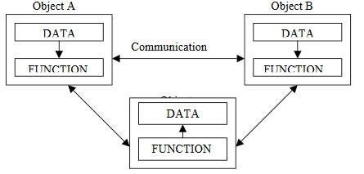
Object Oriented Programming
Emphasis is on data rather than procedure.
Programs are divided into what are known as objects.
Data is hidden and cannot be accessed by external functions.
Objects may communicate with each other through functions.
New data and functions can be easily added whenever necessary.
Follows bottom-up approach in program design

Slide 12
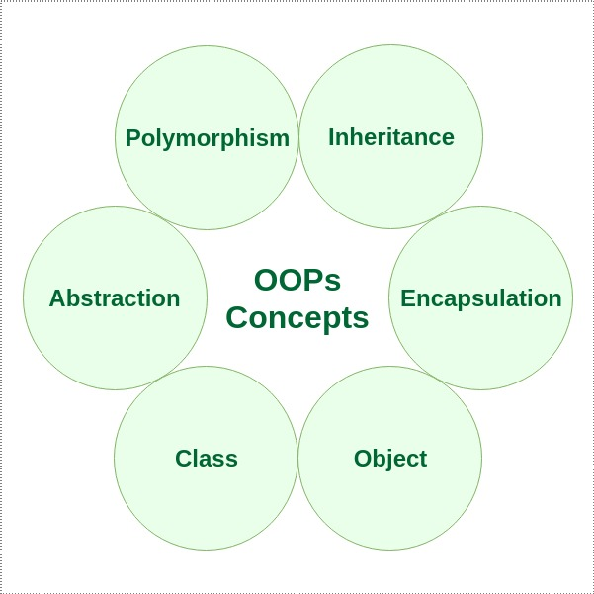
Basic OOP Concepts:
In Object-oriented programming we write programs using classes and objects utilizing features of OOPs such as:
abstraction,
encapsulation,
Inheritance
polymorphism.

Slide 13
Objects
Objects are the basic runtime entities in an object oriented system. They may represent a person, a place, a bank account, a table of data or any item that the program has to handle
Objects: Student
Data
Name
DoB
Marks
Methods
Total
Avg
Display
………….

Slide 14
Class
Object contains data, and code to manipulate that data. The entire set of data and code of an object can be made a user-defined data type with the help of a class
Class : Fruit
Object: Mango

Slide 15
Class
A Class is a 3-Compartment Box encapsulating Data and Functions
Class name (or identifier): identifies the class.
Data Members or Variables (or attributes, states, fields): contains the static attributes of the class.
Member Functions (or methods, behaviors, operations): contains the dynamic operations of the class.
Class Name
Data Members (Static Attributes)
Member Functions (Dynamic Operations)

Slide 16
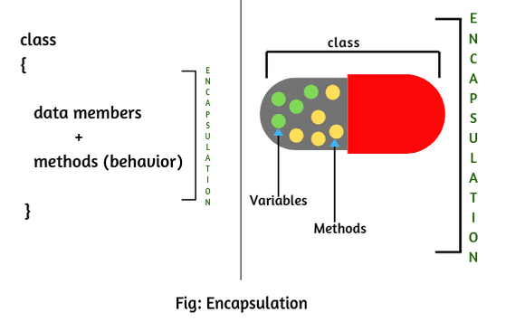
Encapsulation
The wrapping up of data and functions into a single unit is known as encapsulation.
The data is not accessible to the outside world, only those functions which are wrapped in can access it.
The functions provide the interface between the object’s data and the program.
This insulation of the data from direct access by the program is called data hiding or information hiding.

Slide 17
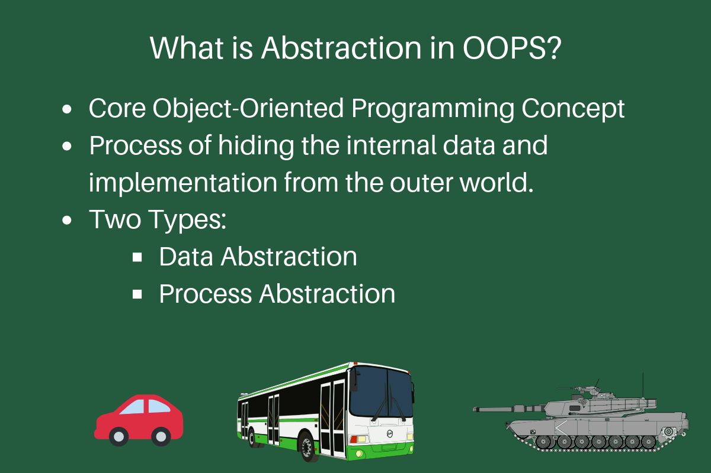
Abstraction
Abstraction refers to the act of representing essential features without including the background details or explanations.
Since classes use the concept of data abstraction, they are known as Abstract Data Types (ADT)

Slide 18
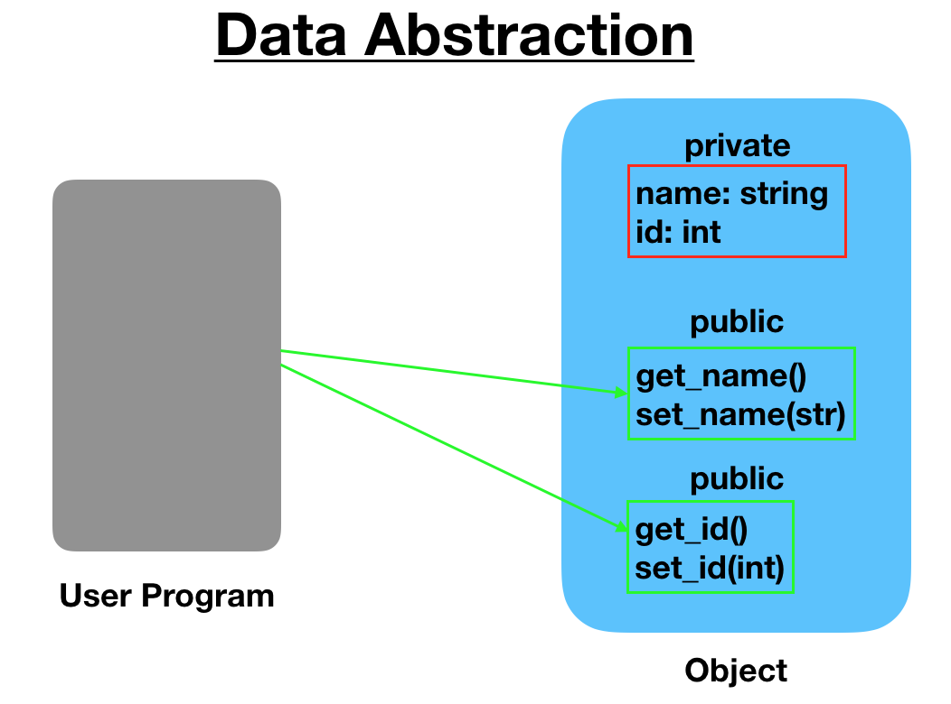

Slide 19
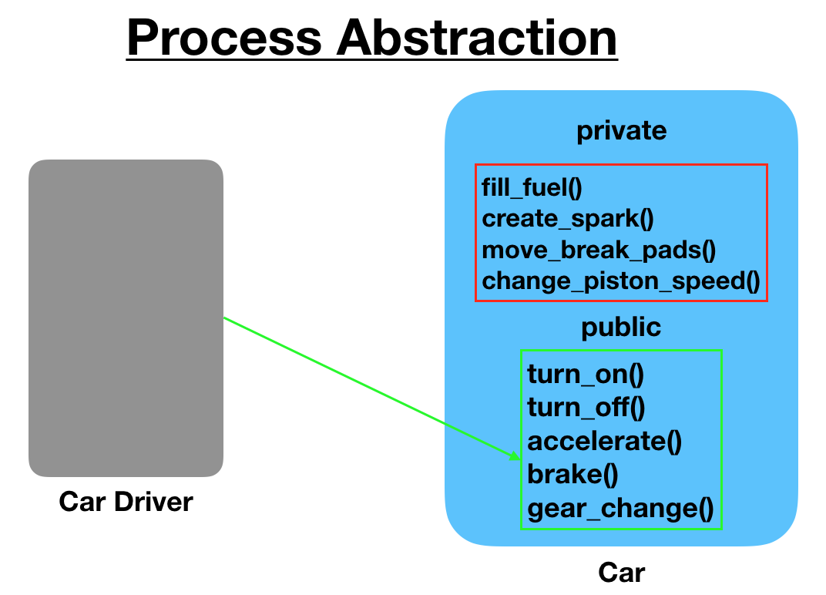

Slide 20
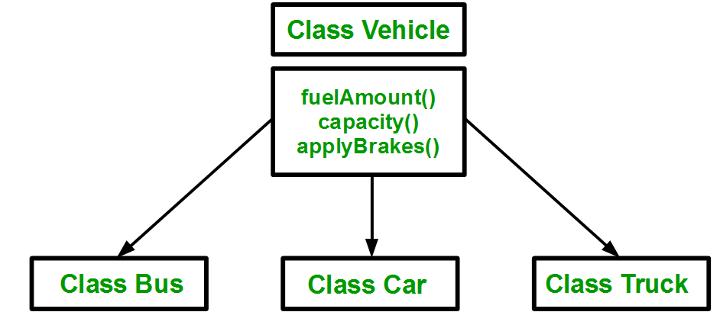
Inheritance
Inheritance is the process by which objects of one class acquire the properties of objects of another class.
In OOP, the concept of inheritance provides the idea of reusability. This means we can add additional features to an existing class without modifying it.

Slide 21
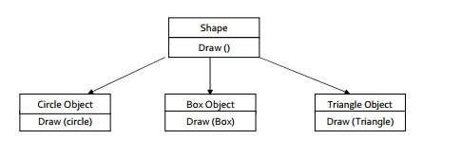
Polymorphism
Polymorphism, (Greek term) - ability to take more than one form.
An operation may exhibits different behaviors in different instances. The behavior depends upon the type of data used in the operation.
For example consider the operation of addition for two numbers; the operation will generate a sum. If the operands are string then the operation would produce a third string by concatenation.
The process of making an operator to exhibit different behavior in different instances is known operator overloading

Slide 22
Benefits of OOP
OOP offers several benefits to both the program designer & the user
Through inheritance, we can eliminate redundant code and extend the use of existing class
We can build programs from the standard working module that communicate with one another, rather than having to start writing code from scratch. This leads to saving of development time & higher productivity.
The principle of data hiding helps the programmer to build & secure programs that cannot be attacked by code in other parts of the program.

Slide 23
It is easy to partition the work in a project based on objects
The data-centered design approach enables us to capture more details of a model in implementable form.
Object-oriented systems can be easily upgraded from small to large systems.
Message passing techniques for communication between objects makes the interface descriptions with external systems much simpler.
Software complexity can be easily managed.

Slide 24
Applications of OOP
Real-business systems are often much more complex and contain many more objects with complicated attributes and methods. OOP is useful in these types of applications because it can simplify a complex problem.
The promising areas for application of OOP include:
Real-time systems
Simulation and modeling
Object-oriented databases
Hypertext, hypermedia
Al and expert systems
Neural networks and parallel programming
Decision support and office automation systems
CAM/CAD systems

Slide 25
Introduction to C++
C++ is an object-oriented programming language.
C++ was developed by Bjarne Stroustrup at AT&T Bell Laboratories in Murray Hill, New Jersey, USA.
C++ is an extension of C with a major addition of the class construct feature.
Since the class was a major addition to the original C language Stroustrup called the new language 'C with Classes'.
However later in 1983 the name was changed to C++.
The idea of C++ comes from the C increment operator ++ thereby suggesting that C++ is an incremented version of C
C++ is a superset of C.
The three most important facilities that C++ adds on to C are classes, function overloading, and operator overloading.

Slide 26
Structure of C++ program
HEADERS
CLASS DECLARATION
MEMBER FUNCTION DEFINITIONS
MAIN FUNCTION

Slide 27
Simple C++ Program
#include<iostream>
using namespace std;
int main()
{
cout<<"Hello C++ Programmer";
return 0;
}

Slide 28
C++ iostream File
#include <iostream>
This directive causes the preprocessor to add the contents of the iostream file to the program.
It contains declarations for the identifier cout and the operator <<.
The header file iostream should be included at the beginning of all programs that use input/output statements.
The header files with .h extension (<iostream.h>) are ”old style”. This representation should be used with old compilers.

Slide 29
namespce
// namespace is used to resolve the conflict
namespce ns1{
void sort()
{----}
}
namespce ns2{
void sort()
{----}
}
ns1::sort(); // this sort is referring to sort of ns1
ns2::sort(); // this sort is referring to sort of ns2

Slide 30
using namespace std
“using namespace std” statement in C++ is a directive that brings all the names in the std namespace into the current scope.
This means that you can use the names of functions, classes, and variables in the std namespace without having to prefix them with std::
For example, instead of writing:
std::cout << "Hello, world!" << std::endl;
You can simply write:
cout << "Hello, world!" << endl;

Slide 31
Input operators
cin >> variable-name;
Meaning: read the value of the variable called <variable-name> from the user
The operator >> is known as extraction or get from operator.
It extracts the value from the keyboard and assigns it to the variable on its right
Example:
cin >> a;
cin >> b >> c;
cin >> x;
cin >> my-character;

Slide 32
Output operators
cout << variable-name;
Meaning: print the value of variable <variable-name> to the user
<< : Is called the insertion or put to operator.
It inserts the contents to the variable on its right to the object on its left.
cout << “any message”;
Meaning: print the message within quotes to the user
cout << endl; Meaning: print a new line
Example:
cout << a;
cout << b << c;
cout << “This is my character:” << my-character << “end” << endl;

Slide 33
Return type of main()
In C++ main() returns an integer type value to the operating system.
Therefore every main() in C++ should end with a return 0 statement otherwise a warning or an error might occur.
Since main() returns an integer type value, return type for main() should be explicitly specified as int.
Note that the default return type for all functions in C++ is int.

Slide 34
Difference b/w C and C++
C Language | C++ Language
Procedural Programming Language | Object Oriented Programming Language
Headerfile : #include<stdio.h> | #include<iostream>
“\n” is used to go to the next line | we can use endl statement
Local variables: declared only at the start of a C program | It can be declared anywhere in a program, before they are used
Return type for a function is optional | Return type must be specified
Do not permit data Hiding | They permit data hiding
By default members are public | class members are private

Slide 35
Tokens(1/4)
The smallest individual units in a program are known as tokens.
C++ has the following tokens:
Keywords
Identifiers
Constants
Strings
operators

Slide 36
Tokens(2/4) There are 95 keywords in C++
asm | double | new | switch
auto | else | operator | template
break | enum | private | this
case | extern | protected | throw
catch | float | public | try
char | for | register | typedef
class | friend | return | union
const | goto | short | unsigned
continue | if | signed | virtual
default | inline | sizeof | void
delete | int | static | volatile
do | long | struct | while
bool | export | reinterpret_cast | typename
const_cast | false | static_cast | using
dynamic_cast | mutable | true | wchar_t
explicit | namespace | typeid

Slide 37
Tokens(3/4)
Identifiers and constants:
Identifiers refer to the names of variables, functions, arrays, classes created by the programmer.
Rules for identifiers
Only alphabetic characters, digits and underscores are permitted.
The name cannot start with digit
Uppercase and lowercase letters are distinct.
Keywords cannot be used.

Slide 38
Tokens(4/4)
Constants:
Constants refer to fixed values that don‟t change during the execution of a program.
C++ supports several kinds of literal constants
They include integers, characters, floating point numbers and strings.
Examples:
const double PI = 3.14159;
123 //decimal constant
12.34 //floating point constant
037 //octal constant
0x2 //hexadecimal constant
“C++” //string constant
‘a’ // character constant
C++ also recognizes all the backslash character constants available in C.

Slide 39
Basic data types(1/3)
C++ data types
User defined data types
Structure
Union
Class
Enumerated type
Built-in type
Integer type
int
char
Floating type
float
double
Void type
Derived type
Array
Function
Pointer

Slide 40
Data Types(2/3)
ANSI C++ committee has added two more data types, bool and wchar_t.
Bool data type:
The variable of type bool hold a boolean value, true or false.
The bool type variables can be declared as:
bool b1; b1=true;
bool b2 = false;
cout << “b1 = “ << b1 << endl << “b2 = ”<< b2;
Will display the following output:
b1 = 1
b2 = 0
The wchar_t data type:
The character type wchar_t has been defined to hold 2-byte wide characters.

Slide 41
Data Types(2/3): Wchar_t example
// An example C++ program to demonstrate use of wchar_t
#include <iostream>
using namespace std;
int main()
{
wchar_t w = 'A';
wcout << "Wide character value:: " << w << endl ;
cout << "Size of the wide char is:: " << sizeof(w);
return 0;
}
Output:
Wide character value:: 65
Size of the wide char is:: 2
//w is prefixed in operations like scanning (wcin) or printing (wcout) while operating wide-char type.

Slide 42
Data Types(3/3)
Void type
The type void was introduced in ANSI C.
Two uses of void are:
To specify the return type of a function when it is not returning any value, and
To indicate an empty argument list to a function.

Slide 43
Operators in C++(1/4)
All C operators are valid in C++.
C++ introduces some new operators which are as follows:
<<
>>
::
::*
->*
.* delete endl new setw
insertion operator (print) extraction operator (read)
scope resolution operator
pointer to member declarator pointer-to-member operator pointer to member operator memory release operator
line feed operator
memory allocation operator field width operator

Slide 44
Operators (2/4)
#include<iostream>
using namespace std;
int x =11; // this x is global
int main()
{
int x = 22;
cout << "In main: x = " << x << endl;
{
int x = 33;
cout << "In block inside main: x = " << x << endl;
}
// access to the global x
cout << "In main: ::x = " << ::x << endl;
return 0;
}
Scope resolution operator( :: )
This operator allows to access the global version of a variable within the inner block.
This operator is used as:
:: variable-name
Output:
In main: x = 22
In block inside main: x = 33
In main: ::x = 11

Slide 45
Operators (3/4)
Memory management operators
New and delete operators
An object can be created by using new, and destroyed by using delete
A data object created inside a block with new, will remain in existence until it is explicitly destroyed by using delete .
The new operator can be used to create objects of any type. It takes the following general form:
Pointer-variable = new data-type;
Pointer variable is a pointer of type data-type.
The new operator allocates sufficient memory to hold a data object of type data-type and returns address of that object.
Examples:
int *p = new int;
float q = new float;
Initialization using new operator:
Pointer-variable = new data-type(size);
where size(a variable) specifies the number of elements in an array.

Slide 46
How is it different from memory allocated to normal variables?
For normal variables like “int a”, “char str[10]”, etc, memory is automatically allocated and deallocated.
For dynamically allocated memory like “int *p = new int[10]”, it is the programmer’s responsibility to deallocate memory when no longer needed.
If the programmer doesn’t deallocate memory, it causes a memory leak (memory is not deallocated until the program terminates).
C uses the malloc() and calloc() function to allocate memory dynamically at run time and uses a free() function to free dynamically allocated memory.
C++ supports also these functions along with new and delete.

Slide 47
Operators (4/4)
delete operator:
When data object is no longer needed, it is destroyed to release the memory space for reuse as :
delete pointer-variable;
The pointer-variable is the pointer that points to a data object created with new.
Examples:
delete p;
delete q;

Slide 48
Manipulators (1/2)
Manipulators:
Operators that are used to format the data display.
Commonly used manipulators are endl and setw.
The endl manipulator, when used in an output statement, causes a linefeed to be inserted.
It has same effect as using the newline character “\n”.
The setw manipulator specifies the field width for the output and print the result in right justified form.

Slide 49
Manipulators (2/2)
Use of endl | Use of setw
int main() { int m=1234,n=56,p=789; cout<<“m = ”<< m << endl << “n = ” << n << endl << “p = ” << p << endl return 0; } output: m =234 n = 56 p = 789 | int main() { int m=1234,n=56,p=789; cout<<“m = ”<<setw(5)<< m << endl << “n = ” << setw(5)<<n << endl << “p = ” <<setw(5)<< p << endl // setw(5) specifies a field width 5 for printing the values return 0; } output: m = 1234 n = 56 p = 789

Slide 50
Control structures(1/5)
Control structures
Branching structure
If-else statement
Switch statement
Loop structure
for loop
while loop
do-while loop

Slide 51
Control structures(2/5)
If-else statement Flow chart
Syntax:
if (condition)
{
conditi on
if block statements;
False
}
else
{
else block statements;
}
True
If block statements
else block
statements

Slide 52
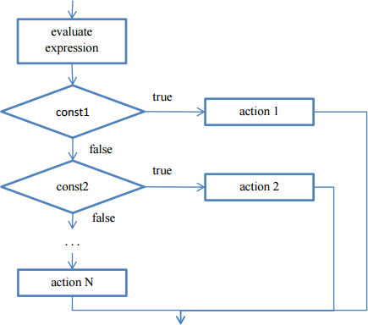
Control structures(3/5)
Switch statement:
Syntax:
switch (expression)
{
case const1: action1; break;
case const2: action2; break;
case const3: action3; break;
...
default:
actionN;
}

Slide 53
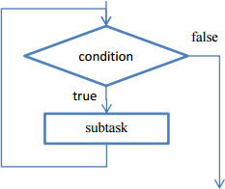
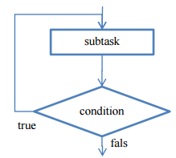
Control structures(4/5)
Iterative constructs
– Iterative construct means that some statements multiple times until some condition is met.
while statements Syntax:
while (condition)
{ subtask;
}
will be executed
do-while statement
Syntax:
do
{
Subtask;
} while (condition);

Slide 54
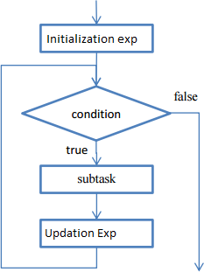
Control structures(2/5)
for statement Syntax:
for (initilization_expression; test_expression; updation_expression)
{
subtask;
}

Slide 55
Classes and Objects
object - An object is an instance of a class which combines both data and functions together.
Method - an action performed by an object (a verb)
Attribute - description of objects in a class
class - a category of similar objects
- does not hold any values of the object’s attributes
By default all members declared inside a class are private to that class

Slide 56
Classes in C++
A class definition begins with the keyword class.
The body of the class is contained within a set of braces, { } ; (notice the semi-colon).
class class_name
{
….
….
….
};
Any valid identifier
Class body (data member + methods)

Slide 57
Class Example
This class example shows how we can encapsulate (gather) a circle information into one package (unit or class)
No other class can access and retrieve this value directly.
The class methods are responsible for that only.
class Circle
{
private:
double radius;
public:
void setRadius(double r);
double getDiameter();
double getArea();
double getCircumference();
};
They are accessible from outside the class, and they can access the data member (radius)

Slide 58
Sample Program using class and object
#include <iostream>
using namespace std;
class Student {
public:
int id;//data member (also instance variable)
string name;//data member(also instance variable)
};
int main() {
Student s1; //creating an object of Student
s1.id = 201;
s1.name = "abc.xyz";
cout<<s1.id<<endl;
cout<<s1.name<<endl;
return 0;
}
Output:
201
abc.xyz

Slide 59
Example: Store and Display Employee Information
#include <iostream>
using namespace std;
class Employee {
public:
int id;//data member
string name;//data member
float salary;
void insert(int i, string n, float s)
{
id = i;
name = n;
salary = s;
}
void display()
{
cout<<id<<" "<<name<<" "<<salary<<endl;
}
};
int main(void) {
Employee e1; //creating an object of Employee
Employee e2; //creating an object of Employee
e1.insert(201, "abc",990000);
e2.insert(202, "xyz", 29000);
e1.display();
e2.display();
return 0;
}
Output:
201 abc 990000
202 xyz 29000

Slide 60
Exercises
Write a program in C++ to find the area of a circle using input value?
Write a program in C++ for Arithmetic operations of two integer numbers?
Write a program in C++ to print the upper case letters to lower case?
Write a program in C++ to show a numeric value of a variable using hex, oct, and dec manipulator functions. ?
Write a program in C++ to check whether the given character is upper, lower, or number not?
Write a program in C++ to find the biggest of three given numbers?
Write a program in C++ to display the name of the day in a week .here the given input range is 1 to 7. ?
Write a program in C++ to display the even or odd numbers between 1 to 100 using a while loop?
Write a program in C++ to print a word form of a given number between 0 to 9 using Switch?
Write a program in C++ to find the smallest of 10 numbers ?

Slide 61
This pointer
Whenever our data members and function arguments are of the same name, the compiler gets confused. this tells the compiler that we are referring to the object’s data member.
this pointer is used to distinguish the data members from the local variable
Every object in C++ has access to its address through an important pointer called this pointer.
Therefore, inside a member function, this may be used to refer to the invoking object.
Only member functions have this pointer.
this pointer is used to access the address of the current object (or instance) of the class

Slide 62
Example: differentiate data members from local variables
#include<iostream>
using namespace std;
Class test
{
int a,b; // data members
Public:
Void show(int x, int y) //x, y are local variables
{
a=x;
b=y;
}
Void display()
{
Cout<<a<<endl<<b;
}
};
int main()
{
Test t; // created an object
t.show(10,20); // 10 is passed to x and 20 is passed to y.
t.display();
return 0;
}
#include<iostream>
using namespace std;
Class test
{
int a,b;
Public:
Void show(int a, int b) //same name as data member
{
a=a; //this will create confusion
b=b; // local variable will be given preference so local a will be copied in a. and same with b.
}
Void display()
{
Cout<<a<<endl<<b;
}
};
Void main()
{
Test t; // created an object
t.show(10,20);
t.display(); // print garbage value.
}

Slide 63
#include<iostream>
using namespace std;
Class test
{
int a, b;
Public:
Void show(int a, int b) //same name as data member
{
this->a=a; // now first a is data member and second a is local variable of the function a
this-> b=b; // can also be written as (*this).b=b
}
Void display(){
Cout<<a<<endl<<b;
}
};
int main()
{
Test t; // created an object
t.show(10,20);
t.display(); // now print a=10 ad b=20.
return 0;
}

Slide 64
Constructor
A constructor is a special member function for the automatic initialization of an object.
Whenever an object of such class is created, the special member function i.e. the constructor will be executed automatically.
Features of constructor:
A constructor name must be the same as that of its class name.
It is declared with no return type (not even void), as it has the same return type as the class.
It cannot be declared as const but a constructor can be invoked with const objects.
It can not be virtual.
It should have public or protected access within the class.
If we do not specify a constructor, C++ compiler generates a default constructor for us.
Constructor can not be inherited.
Constructors are defined in the public section only.

Slide 65
Syntax:
class test
{
private:
--------------
--------------
public:
test(); //constructor created
--------------
};
int main()
{
test t; // constructor initiated
--------------
--------------
return 0;
}

Slide 66
// Fibonacci series using constructor.
#include<iostream>
using namespace std;
class test
{
unsigned long int f0,f1,fib;
public:
test() // constructor created
{
f0=0;
f1=1;
fib=f0+f1;
cout<<f0<<f1;
}
void increment()
{
f0=f1;
f1=fib;
fib=f0+f1;
}
void display()
{
cout<<fib<<‘\t’;
}
};
int main()
{
test t;
for(int i=0;i<10;i++)
{
t.display();
t.increment();
return 0;
}
}

Slide 67
Types of Constructor
Default Constructor: these doesn’t take any argument. It has no parameter.
Parameterized Constructor: It is possible to pass arguments to the constructor.
Copy Constructor: a member function that initializes an object using another object of the same class.

Slide 68
Default Constructor
#include <iostream>
#include <cstring>
using namespace std;
class Cube
{
int side;
public:
Cube() // default constructor with no argument
{
cout<<"Constructor Called";
}
};
int main()
{
Cube c; // default constructor with no parameters
}

Slide 69
Parameterized Constructor:
A default constructor does not have any parameter,
But if you need, a constructor can have parameters. This helps you to assign the initial value to an object at the time of its creation

Slide 70
Parameterized Constructor
#include <iostream>
using namespace std;
class Cube
{
private:
int side;
public:
Cube(int x) // parameterized constructor with argument x
{
side=x;
}
int getData()
{
return side;
}
};
int main()
{
Cube c1(10); // parameterized constructor with parameter 10
Cube c2(20); // parameterized constructor with parameter 20
Cube c3(30); // parameterized constructor with parameter 30
cout << c1.getData()<<endl;
cout << c2.getData()<<endl;
cout << c3.getData()<<endl;
}
Output:
10
20
30

Slide 71
Parameterized Constructor: Example
#include<iostream>
using namespace std;
class myclass{
int a,b;
public:
myclass(int i, int j){
a=i;
b=j;
}
void show(){
cout<<a<<" "<<b;
}
};
int main()
{
myclass ob(3,5);
ob.show();
return 0;
}
Output:
3 5

Slide 72
Copy Constructor
Copy constructors are always used when the compiler has to create a temporary object of a class object.
The copy constructors are used for initialization of an object by another object of the same class.
Normally the compiler automatically creates a default copy constructor for each class and copies the object bit by bit.
But for special cases the programmer creates the copy constructor, known as a user-defined copy constructor.
In such cases, the compiler does not create the default one.
you have to use the const keyword in the argument at the copy constructor to create an object as a copy of a temporary object.

Slide 73
Copy Constructor
#include <iostream>
using namespace std;
class Cube
{
public:
int side;
};
int main()
{
Cube c1;
c1.side=5;
Cube c2(c1); // copy constructor
cout << c2.side<<endl;
}

Slide 74
General format with pointer:
classname(const classname &p)
{
----------
}
There is a danger in copying an object bit by bit if the object contains pointers since the pointer address will be copied in the process resulting in two different objects that share the same memory buffer.
Two ways to call copy constructor is :
Point p2 = p1;
Point p3(p2) ;

Slide 75
Copy constructor
#include<iostream>
using namespace std;
class Point
{
private:
int x, y;
public:
Point(int x1, int y1)
{ x = x1; y = y1; }
/*Copy constructor below*/
Point(const Point &p2)
{
x = p2.x; y = p2.y;
}
int getX() { return x; }
int getY() { return y; }
};
int main()
{
Point p1(10, 15); // Normal constructor is called here
Point p2 = p1; // Copy constructor is called here
Point p3(p2) ; // Copy constructor is called here
// Let us access values assigned by constructors
cout<<"p1.x = "<<p1.getX()<<", p1.y = "<<p1.getY();
cout<<"\np2.x = "<<p2.getX()<<", p2.y = "<<p2.getY();
cout<<"\np3.x = "<<p3.getX()<<", p3.y = "<<p3.getY();
return 0;
}
Output:
p1.x = 10, p1.y = 15
p2.x = 10, p2.y = 15
p3.x = 10, p3.y = 15

Slide 76
Constructor Overloading
Constructor overloading can be defined as the concept of having more than one constructor with different parameters so that every constructor can perform a different task.
This concept is known as Constructor Overloading and is quite similar to function overloading.
A constructor is called depending on the number and type of arguments passed.
While creating the object, arguments must be passed to let the compiler know, which constructor needs to be called.
Constructor with different arguments
sample();
sample(int a);
sample(int a,int b);
sample(int a,int b,int c);

Slide 77
#include <iostream>
using namespace std;
class sample{
private:
int a,b,c;
public:
sample(){
a=0;
b=0;
c=0;
}
sample(int x){
a=x;
b=2;
c=3;
}
sample(int x,int y,int z){
a=x;
b=y;
c=z;
}
void display();
};
void sample::display()
{
cout<<"A="<<a<<endl;
cout<<"B="<<b<<endl;
cout<<"C="<<c<<endl;
}
int main()
{
sample s1;
cout<<"Contents of s1:"<<endl;
s1.display();
sample s2(10);
cout<<"Contents of s2:"<<endl;
s2.display();
sample s3(4,8,12);
cout<<"Contents of s3:"<<endl;
s3.display();
return 0;
}

Slide 78
Output:
Contents of s1:
A=0
B=0
C=0
Contents of s2:
A=10
B=2
C=3
Contents of s3:
A=4
B=8
C=12

Slide 79
Destructor
A destructor is a function that automatically executes when an object is destroyed.
A destructor will have the same name as the class prefixed; along with a tilde (~) and it can neither return a value nor can it take any parameters.
Destructor can be very useful for releasing resources before coming out of the program like closing files, releasing memories, etc.
class username
{
private:
---------------;
public:
username(); //constructor
~username(); //destructor
};

Slide 80
Destructor Example
#include <iostream>
#include <cstring>
using namespace std;
class Cube
{
int side;
public:
~Cube()
{
cout<<"Destructor Called";
}
};
int main()
{
Cube c;
}
Output:
Destructor Called

Slide 81
#include<iostream>
using namespace std;
static int i=0;
class test {
public:
int a,b;
test() //constructor
{
i=i+1;
a=i;
b=0;
}
~test() //destructor
{
cout<<"\nObject Destroyed"<<a;
}
};
int main(){
test t1, t2, t3;
return 0;
}
Destructor Example
Output:
Object Destroyed3
Object Destroyed2
Object Destroyed1

Slide 82
Function
A function is a group of statements that together perform a task. Every C++ program has at least one function, which is main()
A function is known by various names like a method a sub-routine a procedure etc.
Function prototyping/definition:
return_type function_name( parameter list )
{
body of the function
}

Slide 83
Declaring, Defining, and Calling Function
#include<iostream>
using namespace std;
int max(int num1, int num2); // function declaration
int main (){
// local variable declaration:
int a = 100;
int b = 200;
int ret;
ret = max(a, b); // calling a function to get max value.
cout << "Max value is : " << ret << endl;
return 0;
}
// function definition
int max(int num1, int num2) {
// local variable declaration
int result;
if (num1 > num2)
result = num1;
else
result = num2;
return result;
}
Output:
Max value is : 200

Slide 84
Default arguments
#include<iostream>
using namespace std;
void display(char = '*', int = 1); // function declaration
int main() {
cout<<"No argument passed:\n";
display();
cout<<"\n\nFirst argument passed:\n";
display('#');
cout<<"\n\nBoth argument passed:\n";
display('$', 5);
return 0;
}
void display(char c, int n) // function definition
{
cout<<c<<" and ";
cout<<n;
}
Output:
No argument passed:
* and 1
First argument passed:
# and 1
Both argument passed:
$ and 5

Slide 85
Calling a function
Functions are called by their names. If the function is without argument, it can be called directly using its name. But for functions with arguments, we have two ways to call them,
Call by Value
Call by Reference

Slide 86
Call by value
#include<iostream>
using namespace std;
int calc(int x);
int main()
{
int x = 10;
x = calc(x);
cout<<x;
}
int calc(int x)
{
x = x + 10 ;
return x;
}
#include<iostream>
using namespace std;
void calc(int x);
int main()
{
int x = 10;
calc(x);
cout<<x;
}
void calc(int x)
{
x = x + 10 ;
}
Output:
10
Output:
20

Slide 87
Call by reference
void calc(int *p);
int main()
{
int x = 10;
calc(&x); // passing address of x as argument
cout<<x;
}
void calc(int *p)
{
*p = *p + 10;
}
Output:
20

Slide 88
Passing an Object as argument
To pass an object as an argument we write the object name as the argument.
While calling the function the same way we do it for other variables.
Syntax:
function_name(object_name);

Slide 89
// C++ program to show passing of objects to a function
#include<iostream>
using namespace std;
class Example {
public:
int a;
// This function will take an object as an argument
void add(Example E) {
a = a + E.a;
}
};
int main()
{
Example E1, E2; // Create objects
E1.a = 50; // Values are initialized for both objects
E2.a = 100;
cout << "Initial Values \n";
cout << "Value of object 1: " << E1.a<< "\n& object 2: " << E2.a<< "\n\n";
E2.add(E1); // Passing object as an argument to function add()
// Changed values after passing object as argument
cout << "New values \n";
cout << "Value of object 1: " << E1.a<< "\n& object 2: " << E2.a;
return 0;
}
In this code, there is a class “Example” that has an integer variable ‘a’ and a function ‘add’ which takes an object as argument.
The function add() is called by the object E2 and takes another object E1 as an argument.
Inside the add function, the value of the copy of E1 and the value of current object i.e. E2 are added.
However, this modification only affects the copy of E1 that exists within the function's scope, not the original E1 object.
Output:
Initial Values
Value of object 1: 50
& object 2: 100
New values
Value of object 1: 50
& object 2: 150

Slide 90
Friend Class
A friend class can access private and protected members of other classes in which it is declared as a friend.
It is sometimes useful to allow a particular class to access private and protected members of other classes.
Syntax:
friend class class_name; // This is declared in the base class

Slide 91
Friend Class
#include <iostream>
using namespace std;
class ABC {
private:
int private_variable;
protected:
int protected_variable;
public:
ABC()
{
private_variable = 10;
protected_variable = 99;
}
friend class F; // friend class declaration.
};
class F {
public:
void display(ABC &t)
{
cout << "The value of Private Variable = "
<< t.private_variable << endl;
cout << "The value of Protected Variable = "
<< t.protected_variable;
}
};
int main()
{
ABC g;
F fri;
fri.display(g);
return 0;
}
Output:
The value of Private Variable = 10
The value of Protected Variable = 99
Note: We can declare a friend class or function anywhere in the base class body whether it is private, protected, or public block. It works all the same.
Here, class F is declared as a friend inside class ABC. Therefore, F is a friend of class ABC. Now, class F can access the private members of class ABC.

Slide 92
Friend functions
A friend function of a class is defined outside that class scope but it has the right to access all private and protected members of the class.
#include<iostream>
Using namespace std
class base
{
int val1,val2;
public:
void get()
{
cout<<"Enter two values:";
cin>>val1>>val2;
}
friend float mean(base ob);
};
float mean(base ob)
{
return float(ob.val1+ob.val2)/2;
}
void main()
{
base obj;
obj.get();
cout<<"\n Mean value is:"<<mean(obj);
}
Friendship is not mutual. If class A is a friend of B, then B doesn’t become a friend of A automatically.
Friendship is not inherited.

Slide 93
Static Member in a Function
When a variable is declared as static, space for it gets allocated for the lifetime of the program. Even if the function is called multiple times, space for the static variable is allocated only once and the value of the variable in the previous call gets carried through the next function call.
#include <iostream>
#include <string>
using namespace std;
void demo()
{ // static variable
static int count = 0;
cout << count << " ";
// value is updated and will be carried to the next function calls
count++;
}
int main()
{
for (int i=0; i<5; i++)
demo();
return 0;
}
Output:
0 1 2 3 4

Slide 94
Static Data Member
Static data members are class members that are declared using static keywords. A static member has certain special characteristics which are as follows:
Only one copy of that member is created for the entire class and is shared by all the objects of that class, no matter how many objects are created.
They do not belong to any particular instance of a class
It is initialized before any object of this class is created, even before the main starts.
It is visible only within the class, but its lifetime is the entire program.

Slide 95
Class vs. Instance Variable
Student s1, s2, s3;
Instance Variable
s2(rollNo,…)
Class Variable
(Static members stay here)
Class Space
s3(rollNo,…)
s1(rollNo,…)

Slide 96
Static Data Member (Declaration and Definition Syntax)
Declaration: Keyword static is used to make a data member static.
class ClassName{
…
static DataType VariableName;
};
Definition: Scope resolution operator is used.
class ClassName{
…
static DataType VariableName;
};
DataType ClassName::VariableName;
Static data member is declared inside the class. (at this stage memory is not allocated)
But they are defined outside the class using the scope resolution operator. (at this stage memory is allocated)
Static data members are initialized once and can be initialized at the time of definition.

Slide 97
Example
class Student{
private:
static int noOfStudents; // declaration
public:
…
};
int Student::noOfStudents = 0; //definition and initialization
/*private static member cannot be accessed outside the class except for initialization*/

Slide 98
Initializing Static Data Member
If static data members are not explicitly initialized at the time of definition then they are by default initialized to 0
int static Student::noOfStudents;
is equivalent to
int static Student::noOfStudents=0;

Slide 99
Accessing Static Data Member
To access a static data member there are two ways
Access like a normal data member
Access using a scope resolution operator ‘::’
class Student{
public:
static int noOfStudents;
};
int Student::noOfStudents;
int main(){
Student std;
std.noOfStudents = 1; // normal method
Student::noOfStudents = 1; // using scope resolution operator
}

Slide 100
Life of Static Data Member
They are created even when there is no object of a class
They remain in memory even when all objects of a class are destroyed

Slide 101
Example: normal variable
#include<iostream>
using namespace std;
class base {
public:
int x;
};
int main()
{
base b1,b2;
b1.x=10;
b2.x=20;
cout<<"b1.x = "<<b1.x<<endl;
cout<<"b2.x = "<<b2.x<<endl;
return 0;
}
Output:
b1.x = 10
b2.x = 20

Slide 102
Example: static variable
#include<iostream>
using namespace std;
class base {
public:
int x;
static int y; // declaration
};
int base::y; // definition (or the memory allocation)
int main()
{
base b1,b2;
b1.x=10;
b2.x=20;
b1.y=30;
b2.y=40;
cout<<"b1.x = "<<b1.x<<endl;
cout<<"b2.x = "<<b2.x<<endl;
cout<<"b1.y = "<<b1.y<<endl;
cout<<"b2.y = "<<b2.y<<endl;
return 0;
}
Output:
b1.x = 10
b2.x = 20
b1.y = 40
b2.y = 40
x is different for different objects but y is one for all the objects.
Normal variables are the attributes of objects
Whereas static variable is the attribute of classes

Slide 103


X:
Y:
30
40
b1
b2
X=10
Y=
X=20
Y=

Slide 104
Static Member Function
Static Member Functions
Just like static data members we have static member functions that are used for a specific purpose.
To create a static member function we need to use the static keyword while declaring the function.
Syntax: static return_type function_name()
A static function can only access other static members (data or functions) present in the same class. They cannot access any non-static members.
Since static member functions are class properties and not object properties.
To access them we need to use the class name instead of the object name.
Static member functions are called using the class name.
Syntax: class_name::function_name( )

Slide 105
Example
class Student{
static int noOfStudents;
int rollNo;
public:
static int getTotalStudent(){
return noOfStudents;
}
};
int main(){
int i = Student::getTotalStudents();
}

Slide 106
Example: static function
#include<iostream>
using namespace std;
class base {
public:
int x;
static int y;
void printx()
{
cout<<"x = "<<x<<endl;
}
static void printy()
{
cout<<"y = "<<y<<endl;
}
};
int base::y; // definition (or memory allocation)
int main()
{
base b1,b2;
b1.x=10;
b2.x=20;
b1.y=30;
b2.y=40;
b1.printx();
b2.printx();
b1.printy();
b2.printy();
return 0;
}}
X:
Y:
30
Output:
b1.x = 10
b2.x = 20
b1.y = 40
b2.y = 40
b1
b2
X=10
Y=
X=20
Y=
Static functions can access the values of only static data members, whereas normal members can access static as well as non-static both.

Slide 107
Global Variable vs. Static Members
Alternative to static member is to use global variable
Global variables are accessible to all entities of the program
Against information hiding

Slide 108
Inline Functions
C++ provides inline functions to reduce the function call overhead.
An inline function is a function that is expanded in line when it is called.
When the inline function is called, the whole code of the inline function gets inserted or substituted at the point of the inline function call.
This substitution is performed by the C++ compiler at compile time.
An inline function may increase efficiency if it is small.
Syntax:
inline return-type function-name(parameters)
{
// function code
}

Slide 109
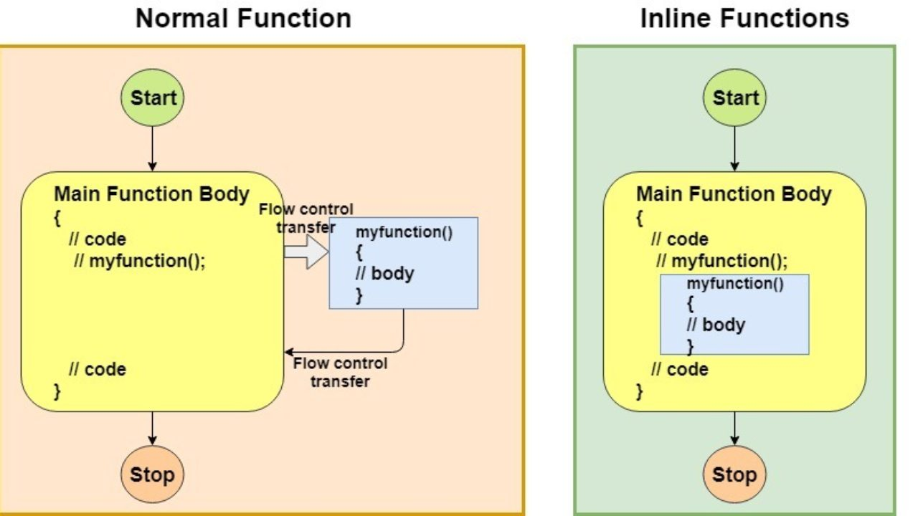

Slide 110
Inline function
Remember, inlining is only a request to the compiler, not a command. The compiler can ignore the request for inlining.
The compiler may not perform inlining in the following circumstances:
If a function contains a loop. (for, while and do-while)
If a function contains static variables.
If a function is recursive.
If a function return type is other than void, and the return statement doesn’t exist in a function body.
If a function contains a switch or goto statement.
#include <iostream>
using namespace std;
inline int cube(int s)
{
return s * s * s;
}
int main()
{
cout << "The cube of 3 is: " << cube(3) << "\n";
return 0;
}
output:
The cube of 3 is: 27

Slide 111
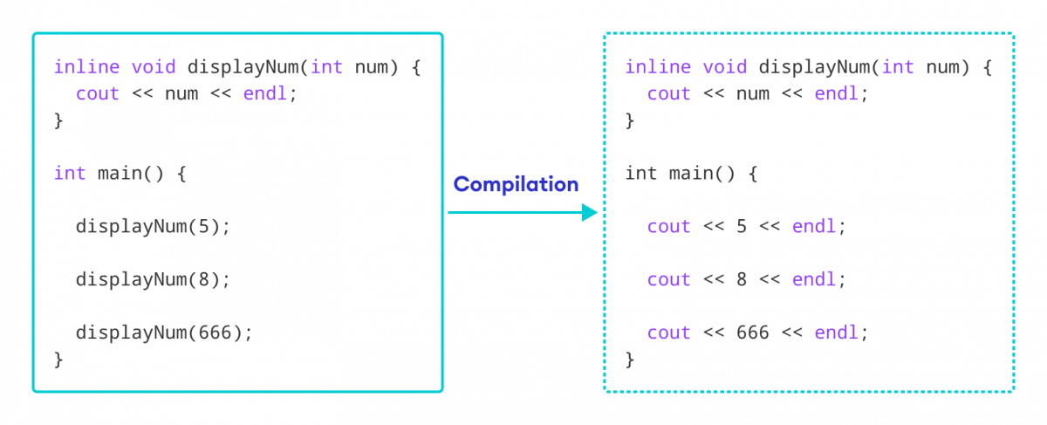
Inline Function: How it works
#include <iostream>
using namespace std;
inline void displayNum(int num) {
cout << num << endl;
}
int main() {
displayNum(5); // first function call
displayNum(8); // second function call
displayNum(666); // third function call
return 0;
}

